Slide 1
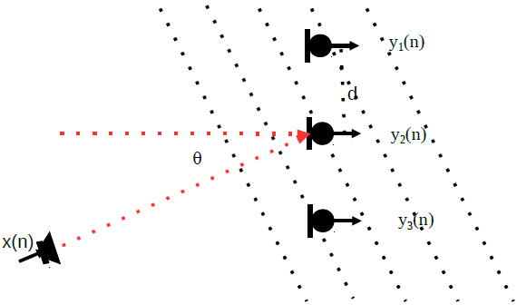
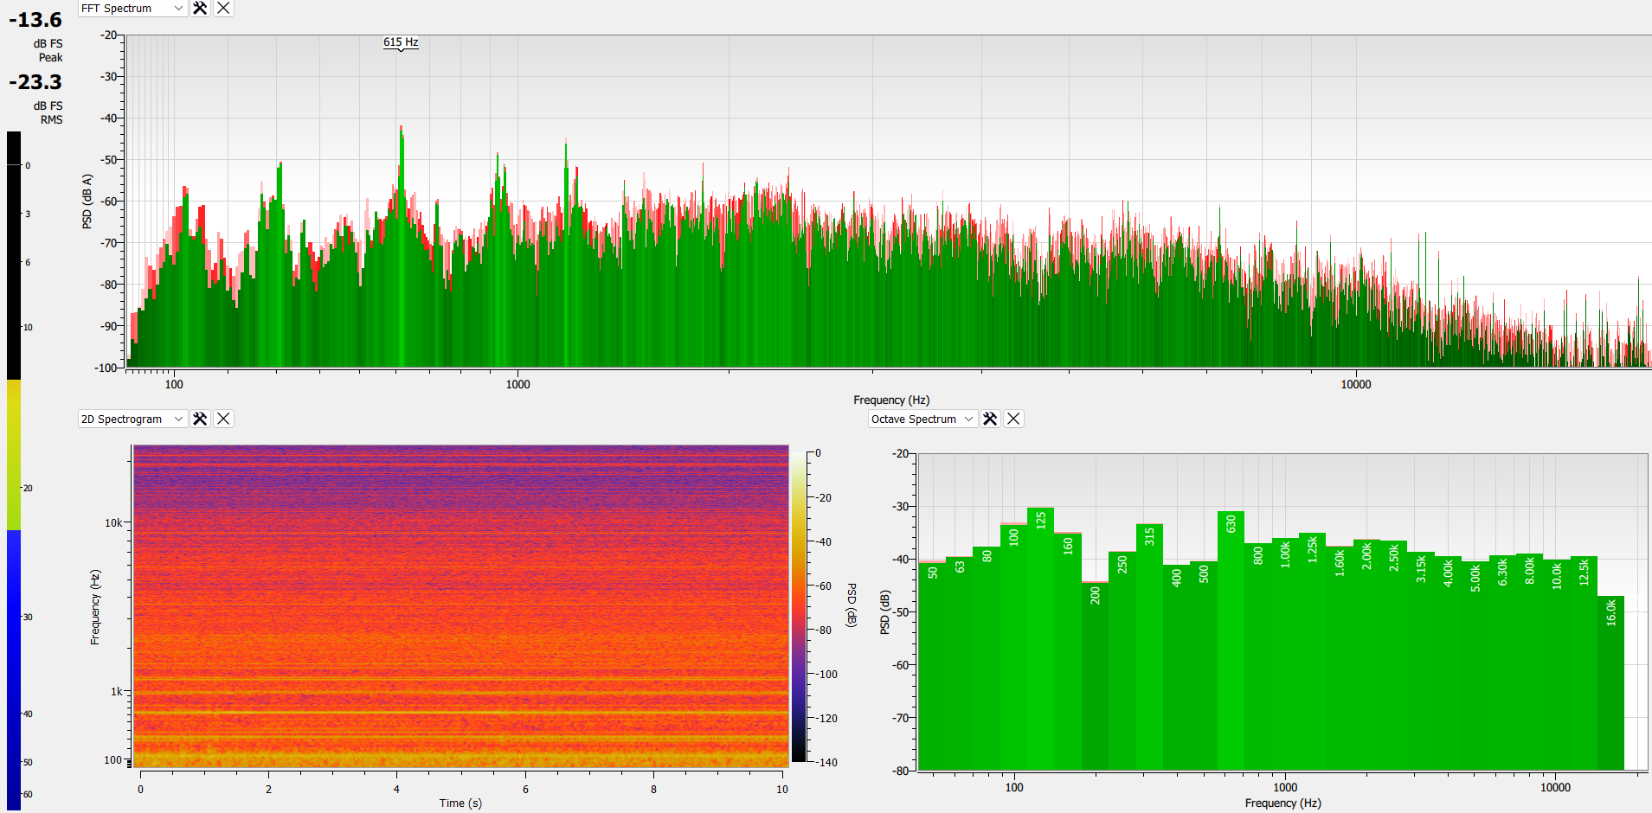
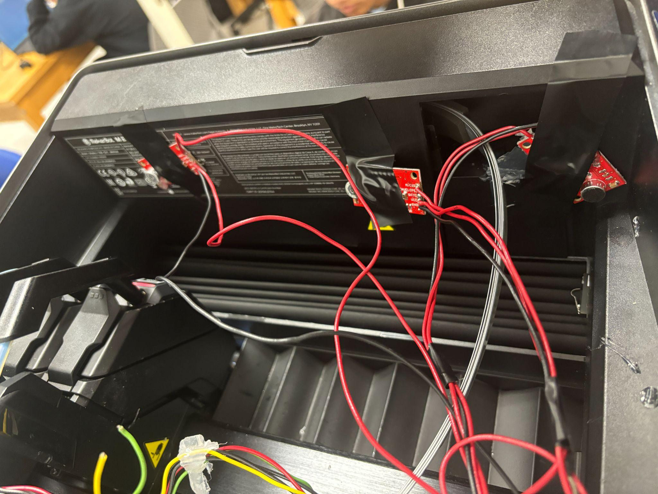
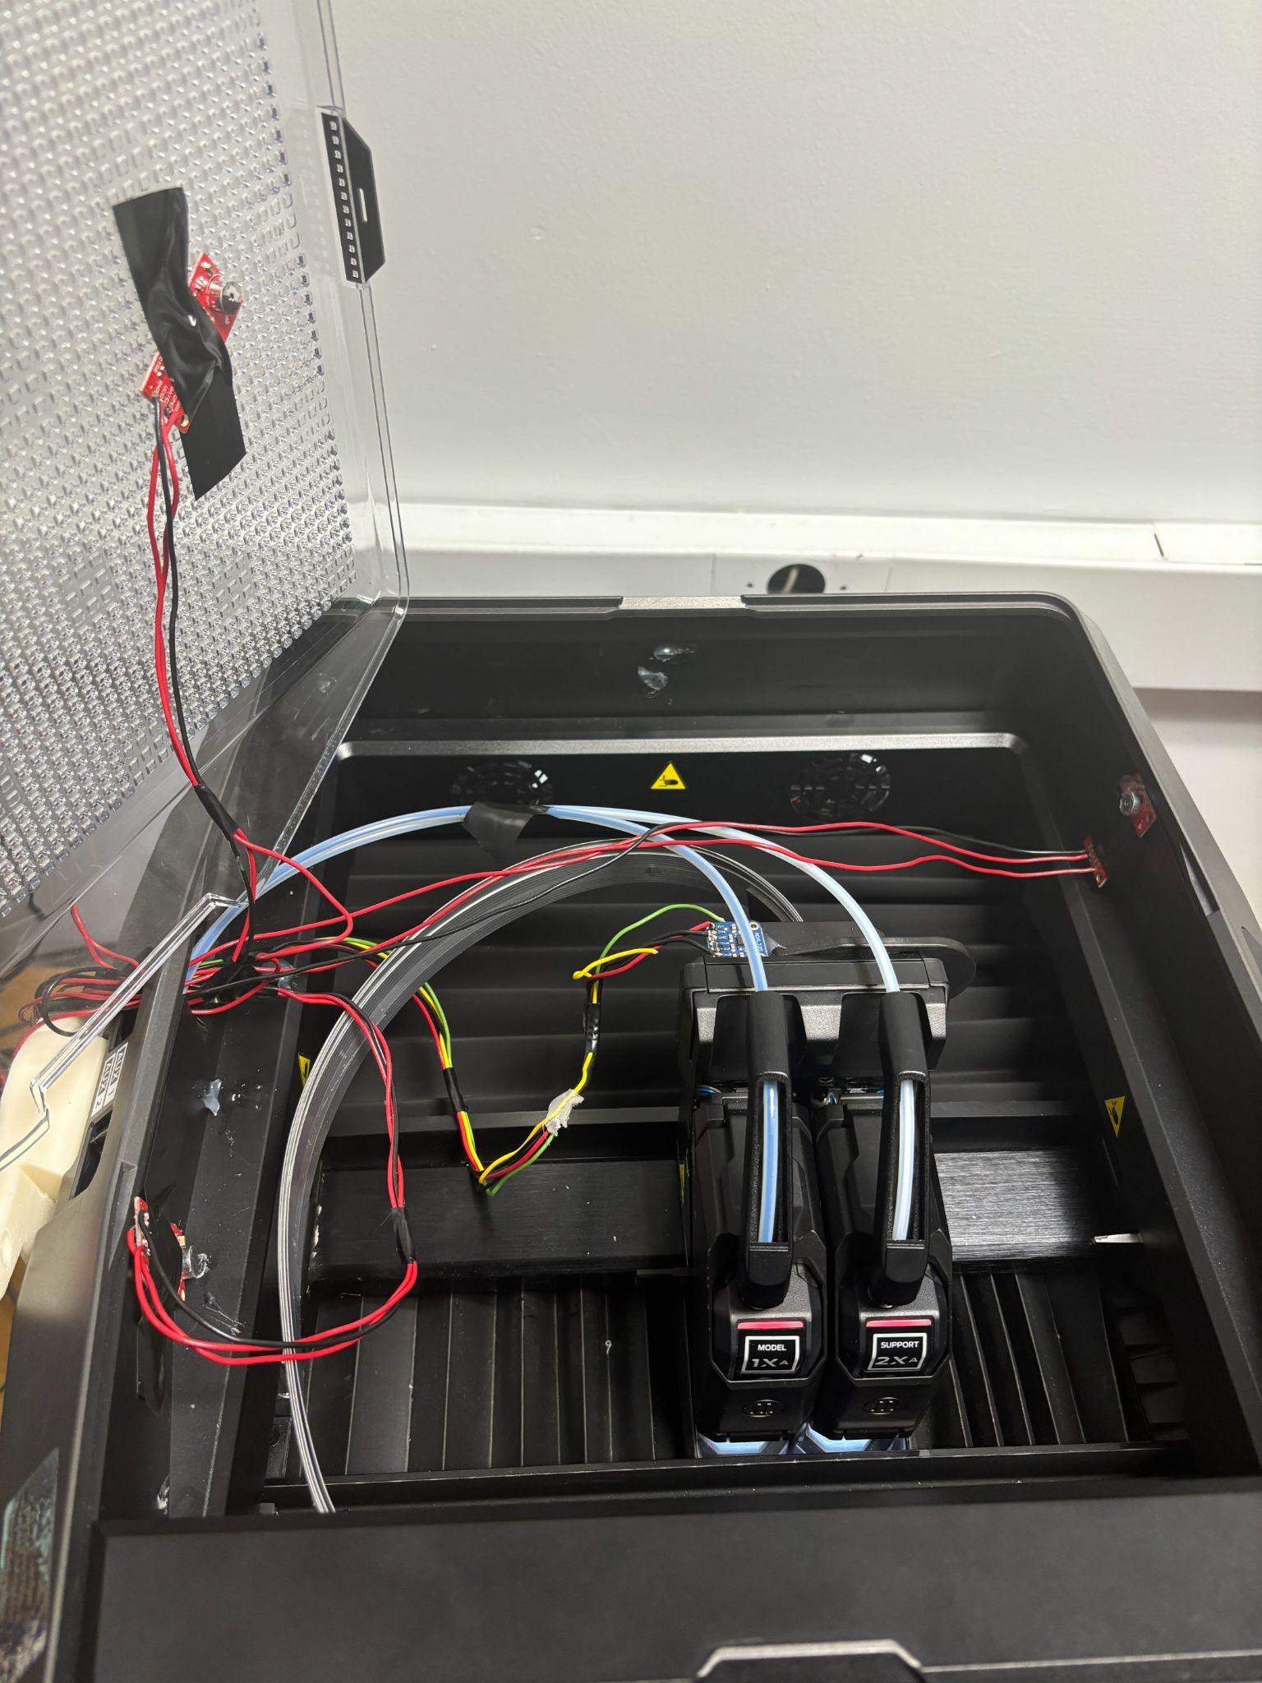

Document and analyze results,
Acoustics Sensor Arrays In 3D Printing
Mentor: Muhammad Fasih Waheed Mentee: Mekhi Connor, Malik Lewis Supervisor: Shonda Bernadin Ph.D.
FAMU|FSU College of Engineering, ECE Research Program, Tallahassee, FL 32310, USA
Abstract
This research investigates the integration of acoustic sensor arrays for fault detection and quality control in 3D printing. Leveraging the established use of acoustic sensors for problem detection across various fields, this study explores their potential for real-time monitoring and adjustment in 3D printing processes. The aim is to improve the reliability and output quality of 3D printed objects while enabling early error detection to ensure optimal printer operation throughout the printing process.
Objective
Familiarize ourselves with 3D printer condition monitoring and CAD design.
Learn about acoustic array sensors and their application in 3D printers.
Implement and test different types of acoustic arrays for 3D printer monitoring.
Document and present findings, demonstrating the potential of acoustic sensor arrays in improving 3D printing processes.
R
Ref. Figure 1
Methods
Record wave forms from acoustic sensors for fault detection and quality control within the 3D printer.
Configured the acoustics sensors with in the 3D printer to implement angular and linear beamforming on the microphones .
Used Friture to analyze the frequency patterns between linear beam formatting and angular beam formatting.
Results
Comparing linear and angular beamforming techniques during a 3D printer's purging process revealed distinct performance differences. Linear beamforming captured a broader range of sounds, including significant fan noise, with frequencies primarily between 311 Hz and 1384 Hz, occasionally exceeding this range. In contrast, angular beamforming, utilizing sensors on the left, right, and top panels, (as seen in Fig 1.2.) focused on a narrower frequency range of 311 Hz to 938 Hz, with occasional peaks up to 1184 Hz. Notably, angular beamforming demonstrated superior effectiveness in filtering out background noise, particularly fan sounds, making it more adept at isolating relevant acoustic data during the 3D printing process.
Conclusion
This study demonstrates the potential of acoustic sensor arrays to enhance 3D printing quality control. Comparing linear and angular beamforming techniques revealed that angular beamforming is superior in isolating relevant signals from background noise, operating in a narrower frequency range Angular arrays were particularly effective at filtering out fan noise, suggesting improved capability for real-time monitoring and error detection in 3D printing processes. While linear arrays captured a broader frequency range, they were more susceptible to background interference.
These findings indicate that integrating acoustic sensor arrays, especially those using angular beamforming, could significantly improve print quality, reduce waste, and enhance process reliability in 3D printing. Further research is needed to quantify these improvements and explore the potential of combining both array types.
Reference
“Linear Array Beamforming.” VOCAL Technologies, vocal.com/beamforming-2/linear-array-beamforming/. Accessed 22 July 2024.
ACKNOWLEDGEMENTS
The team would like to acknowledge the collaborative efforts of Asterix, KCNSC, FAMU-FSU College of Engineering, Dr. Bernadin, Fasih Waheed and Nancy Joseph for providing this opportunity.
Frequency from Linear Microphone array
Fig 1.1. Linear Microphone Array
Fig 1.2. Angular Microphone Array

